Slide 1
Weekly meeting 10
Shengya Guo, CR/AVS3, 04.09.2024

Slide 2
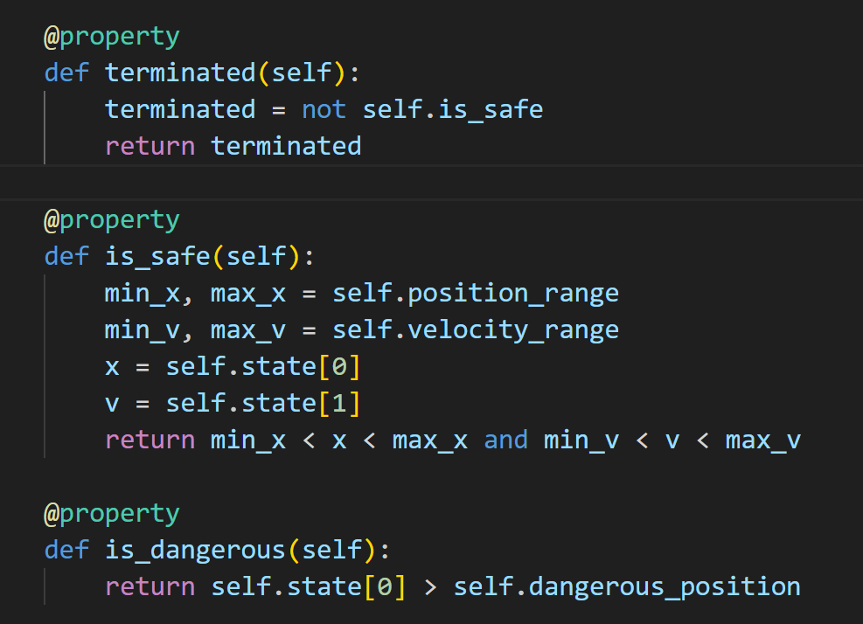
Terminated and truncated
Terminated if the position or velocity ran out of the save zone.
Truncated if the step reach 300, which equal to 300ms.

Slide 3
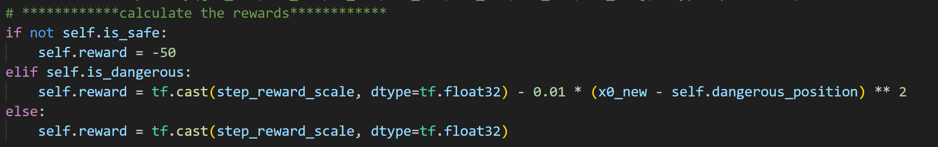
Reward calculation
self.position_range = (-100, 100)
self.velocity_range = (-500, 500)
self.dangerous_position = 75

Slide 4
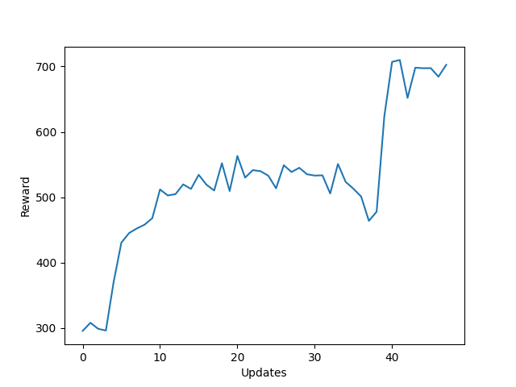
Training progress
Training with the original FIM

Slide 5
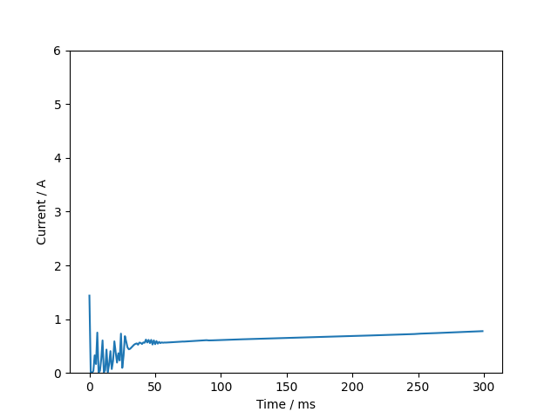
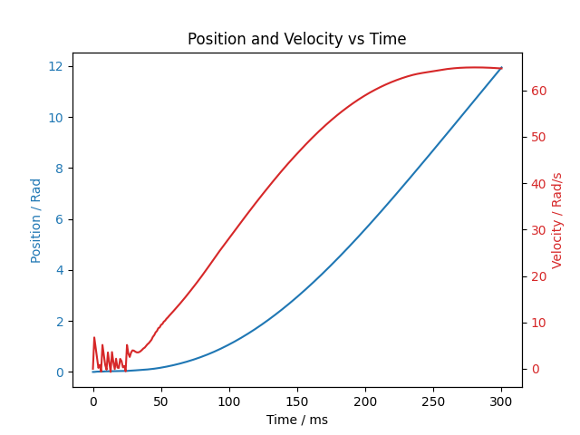
Result
Training with the original FIM

Slide 6
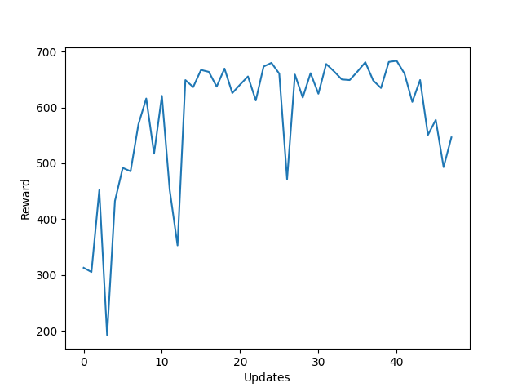
Training progress
Training with the scaled FIM

Slide 7
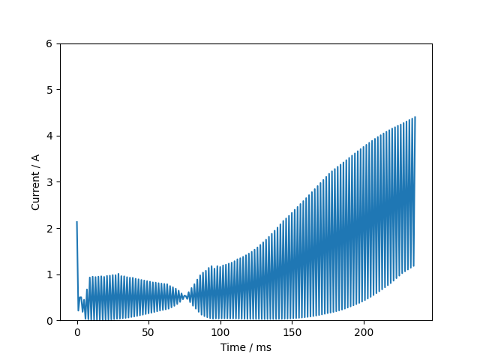
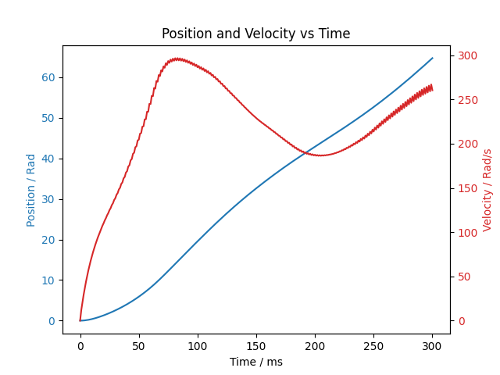
Result
Training with the secaled FIM

